Slide 1

By:
D.SATHWIK REDDY (17311A05J4)
M. ABHINAY (17311A05P1)
S.VIKAS REDDY(16311A05S4)

Slide 2

Abstract
Software Requirements
Hardware Requirements
Existing System
Proposed System
UML Diagrams
Implementation
Output Screenshots

Slide 3
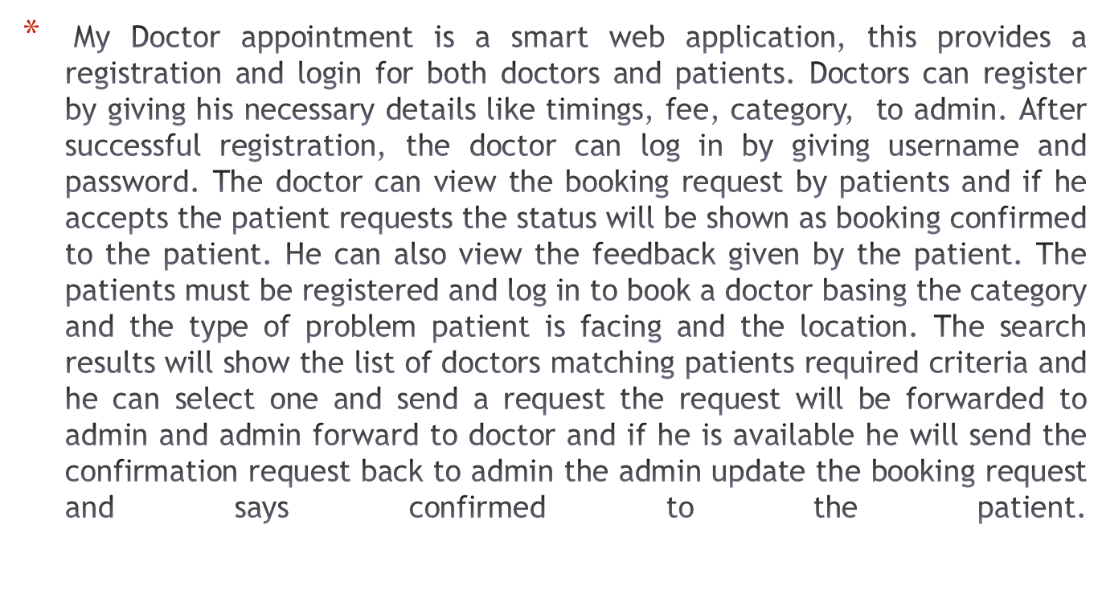
Abstract

Slide 4
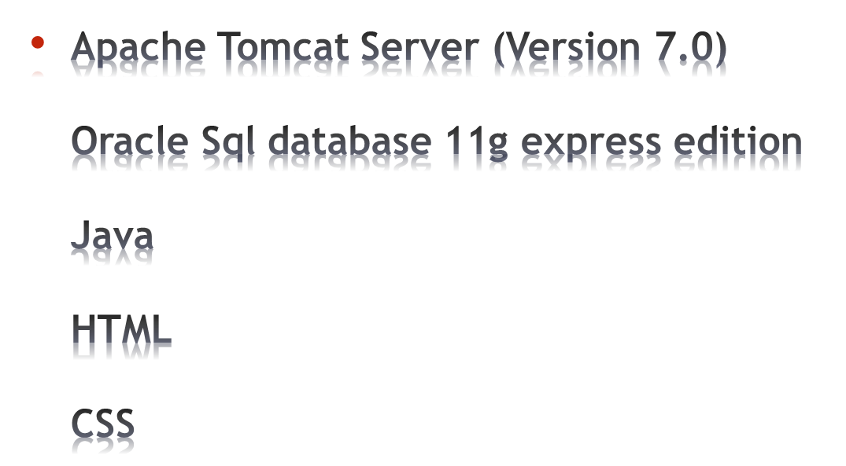
Software Requirements

Slide 5
Hardware Requirements
Operating System:Windows 7 or above
RAM: 4 GB
Processor: i3 or above

Slide 6
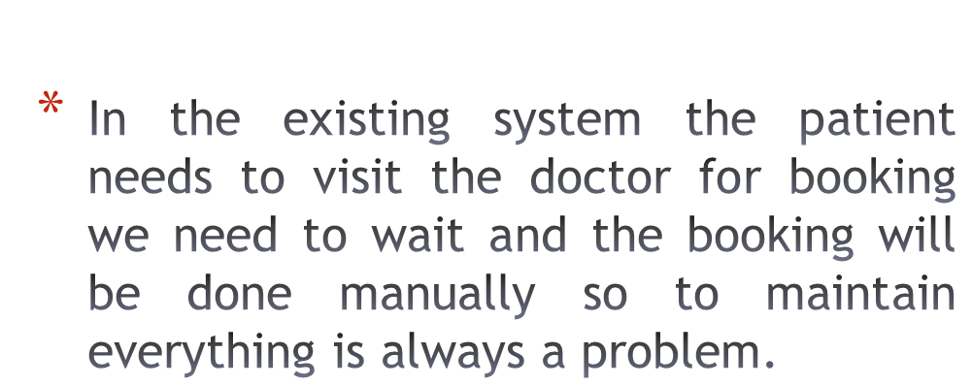
Existing System

Slide 7
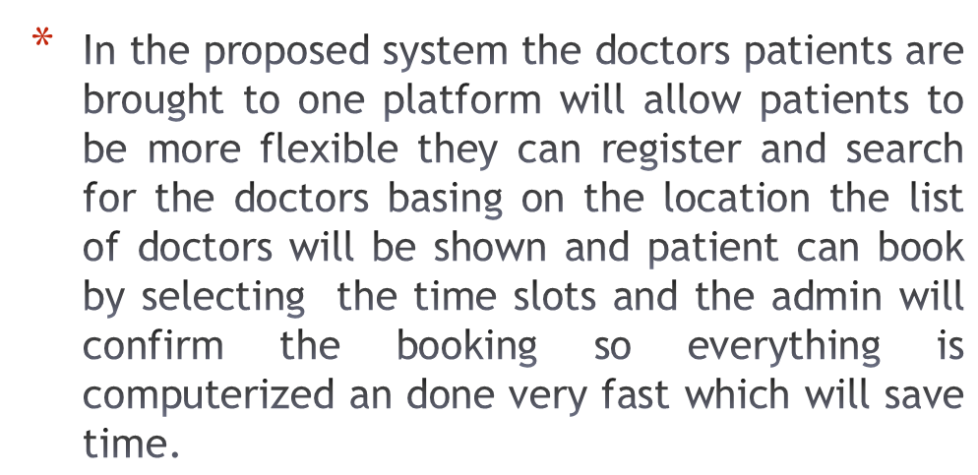
Proposed System

Slide 8


Slide 9


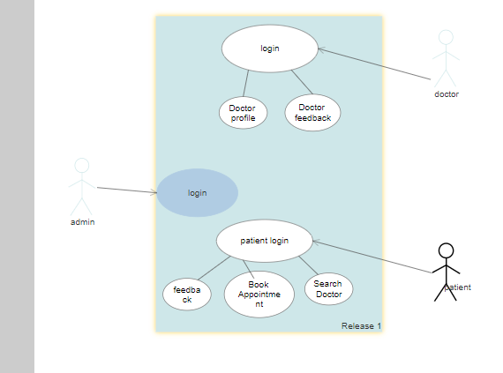

Slide 10

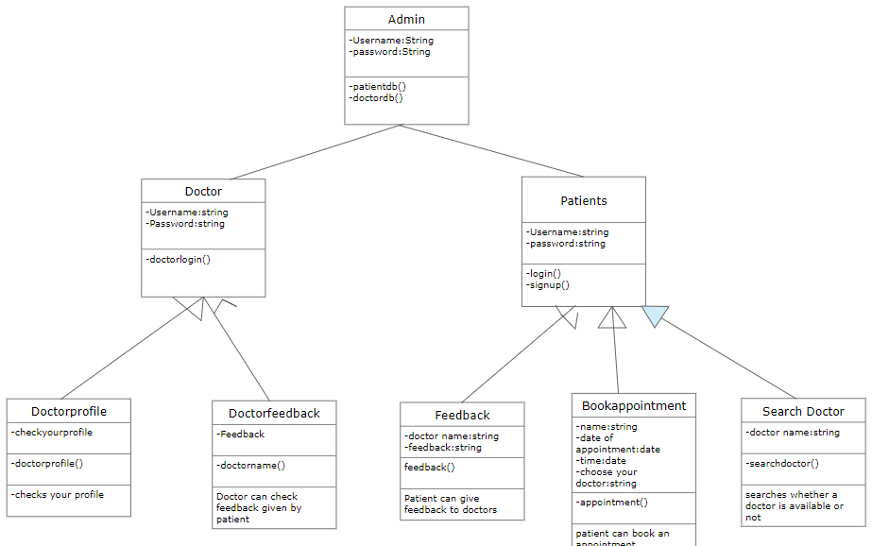

Slide 11
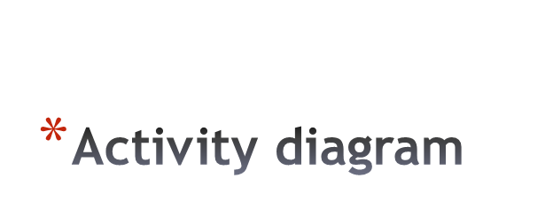
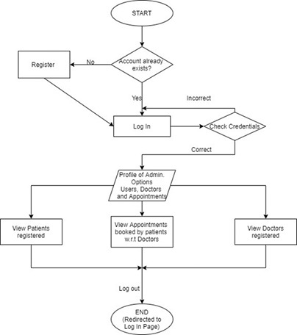
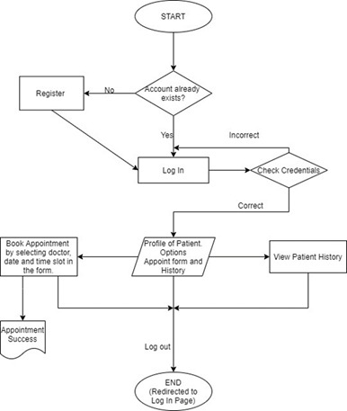

Slide 12

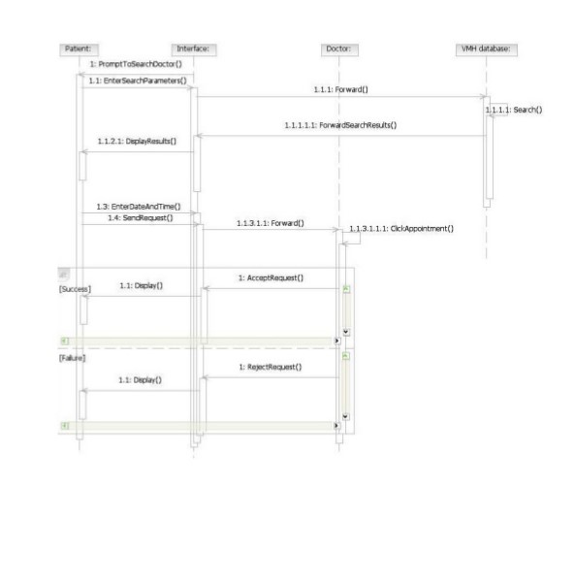

Slide 13
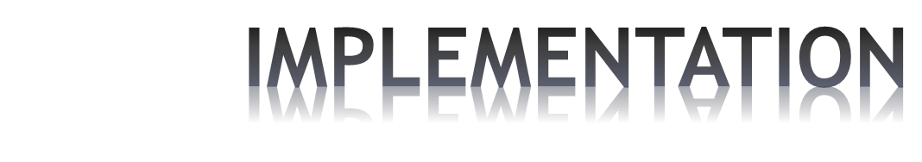
We have implemented this using Apache Tomcat Server, Oracle 11g Database, Sublime Text
One can signup using our app and book an appointment with a doctor and also give feedback to them.
A doctor can confirm and cancel appointments, review the feedback given by concerned patients.
Coming to admin he can doctors via database, check the functionality of the web application.

Slide 14
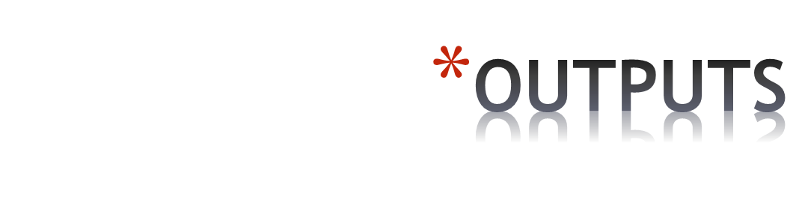
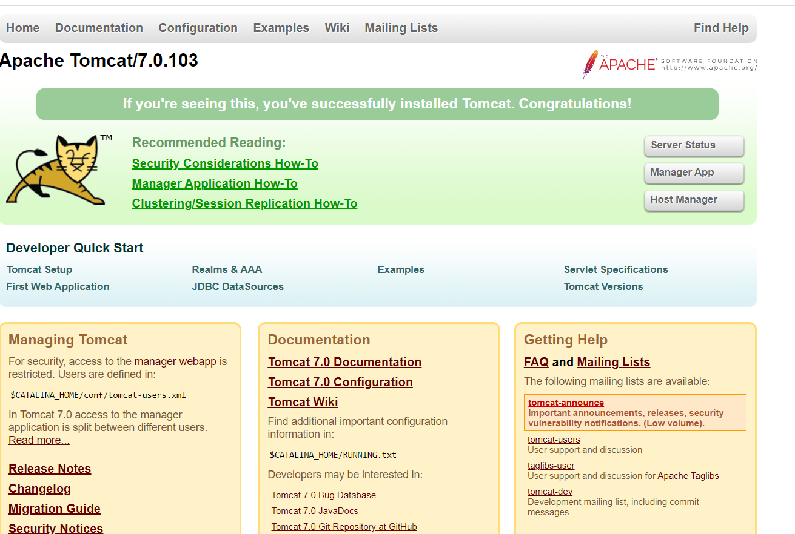

Slide 15

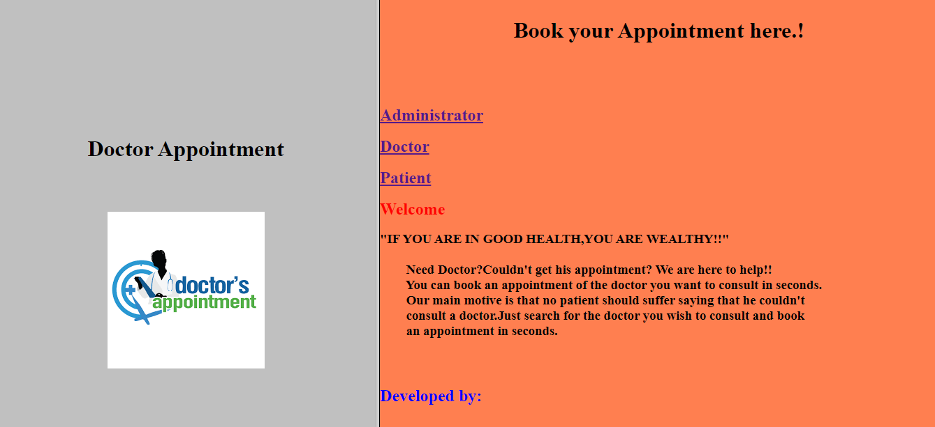

Slide 16
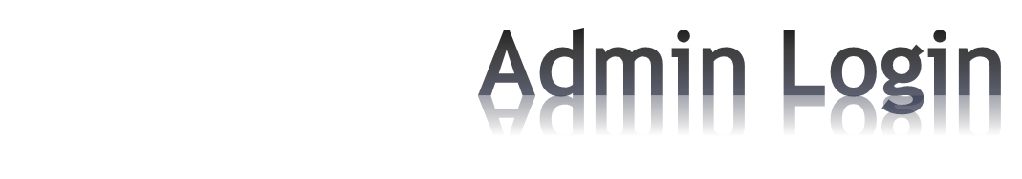
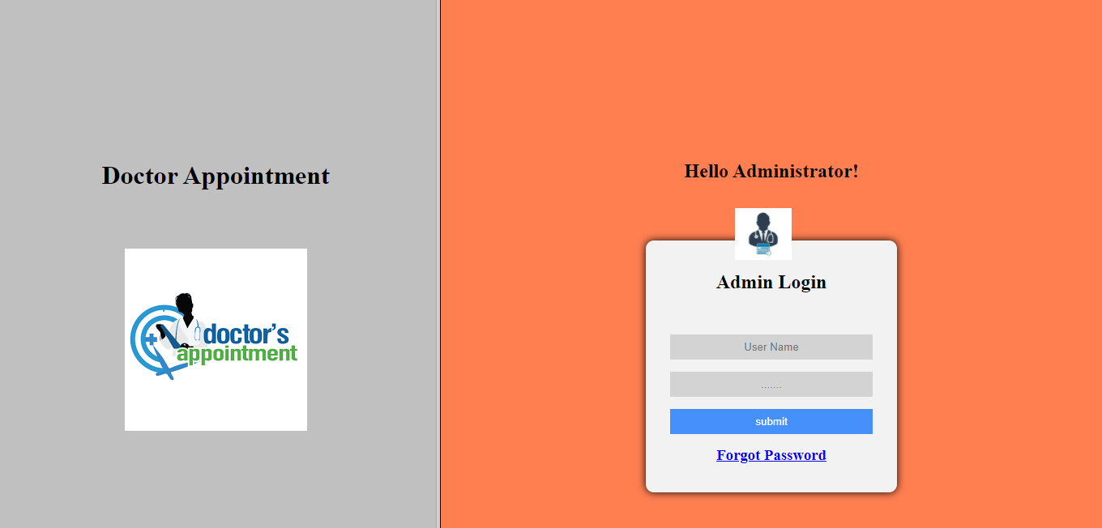

Slide 17

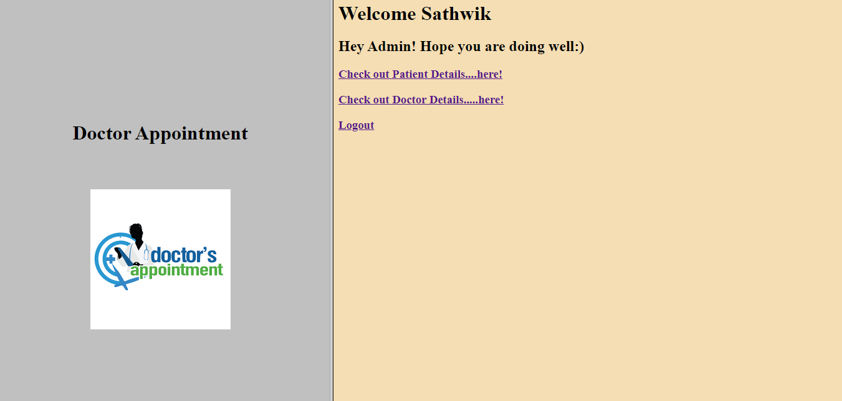

Slide 18
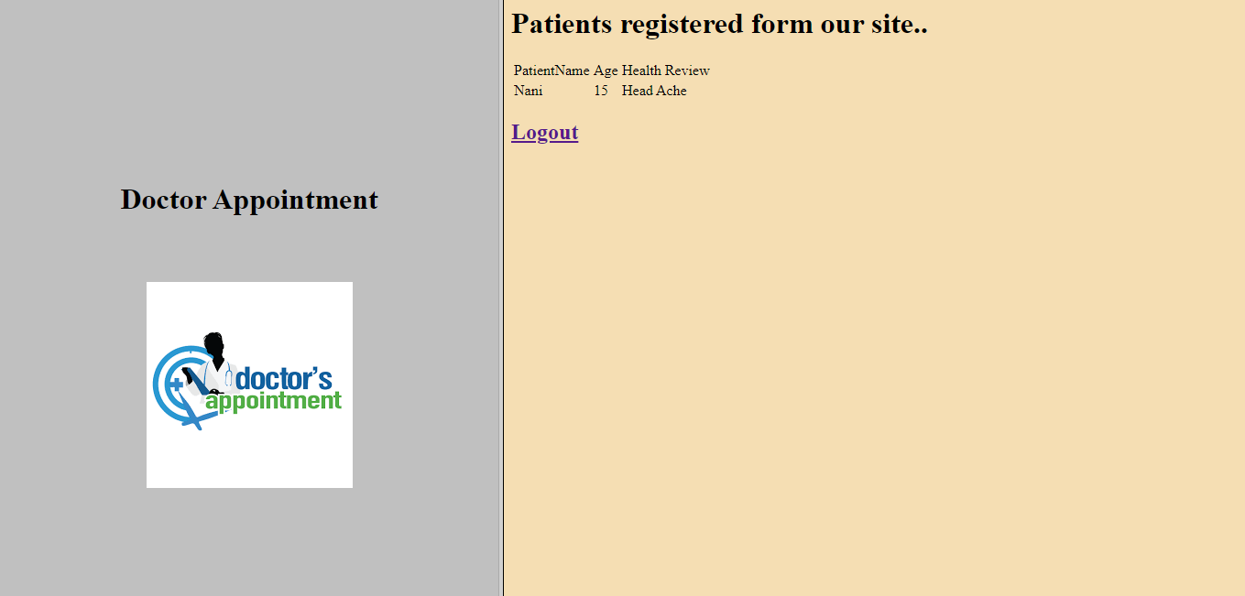

Slide 19
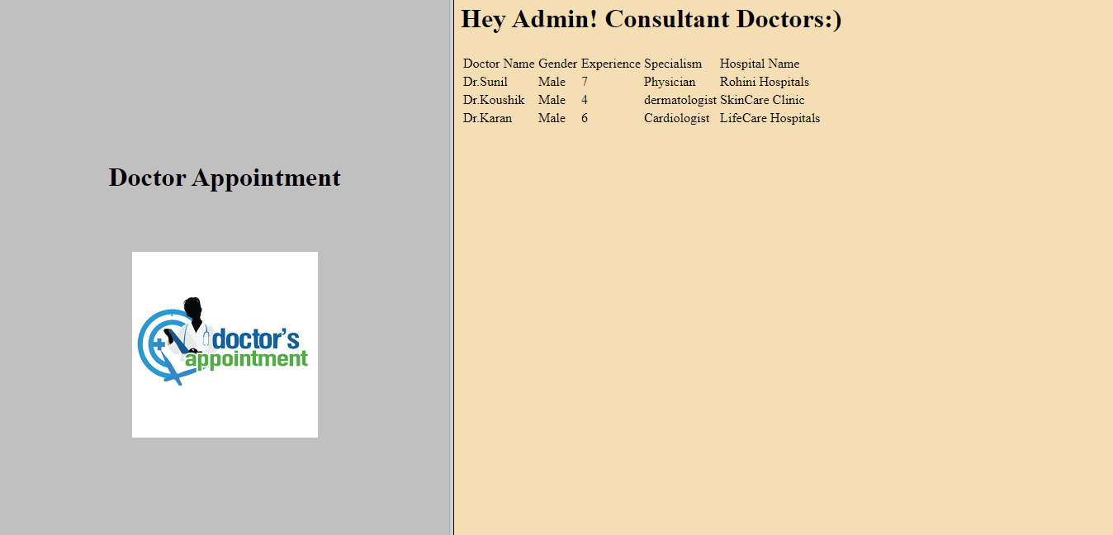

Slide 20
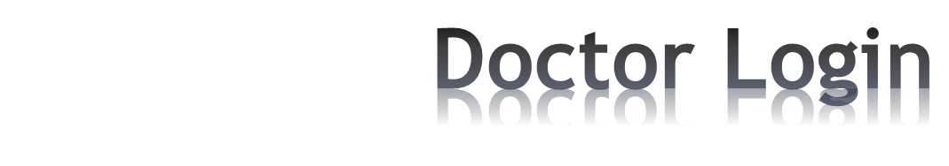
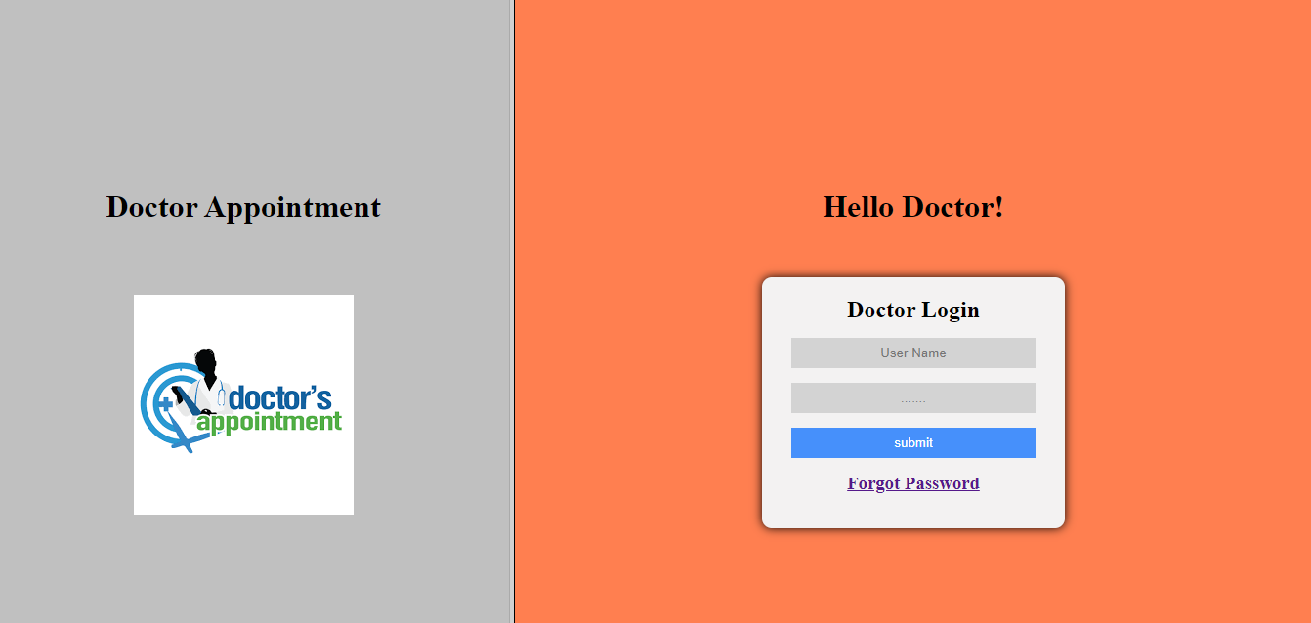

Slide 21

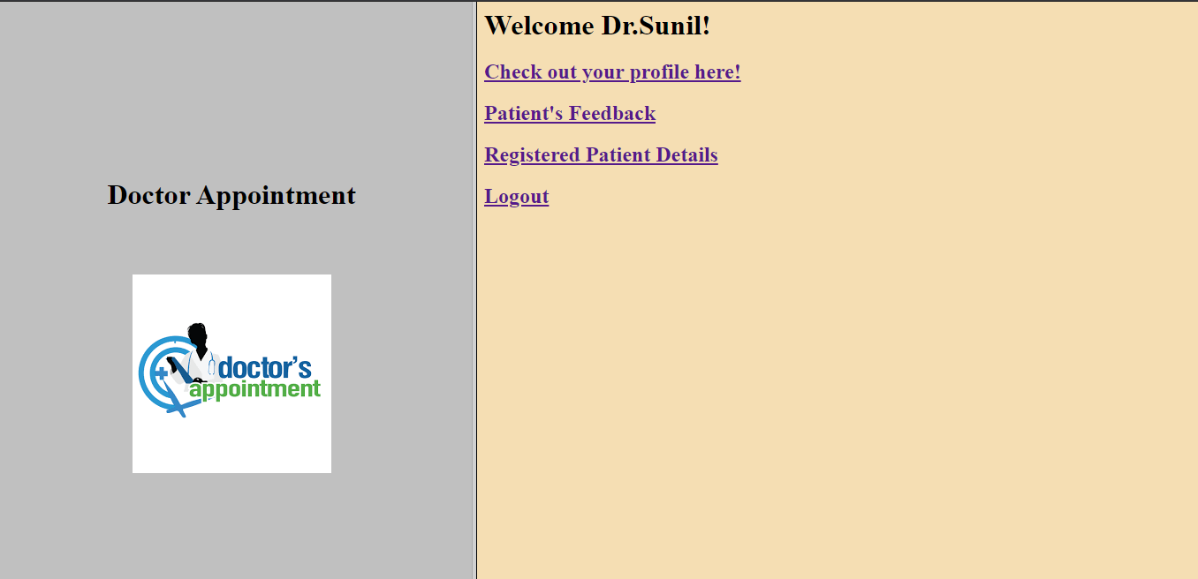

Slide 22
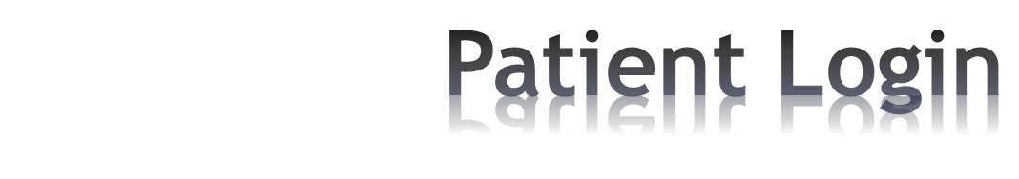
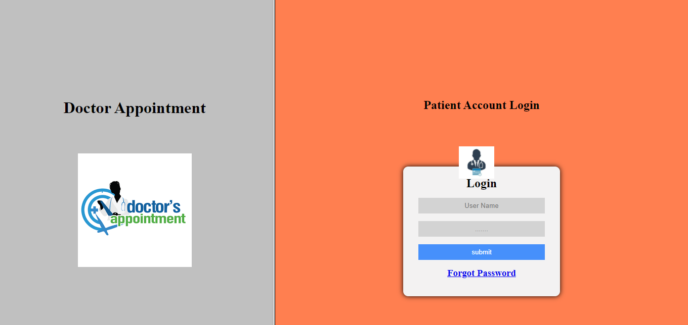

Slide 23
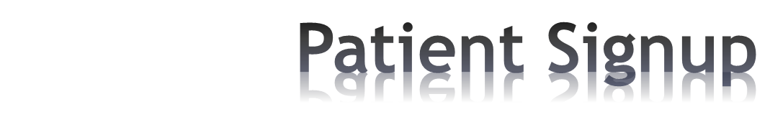
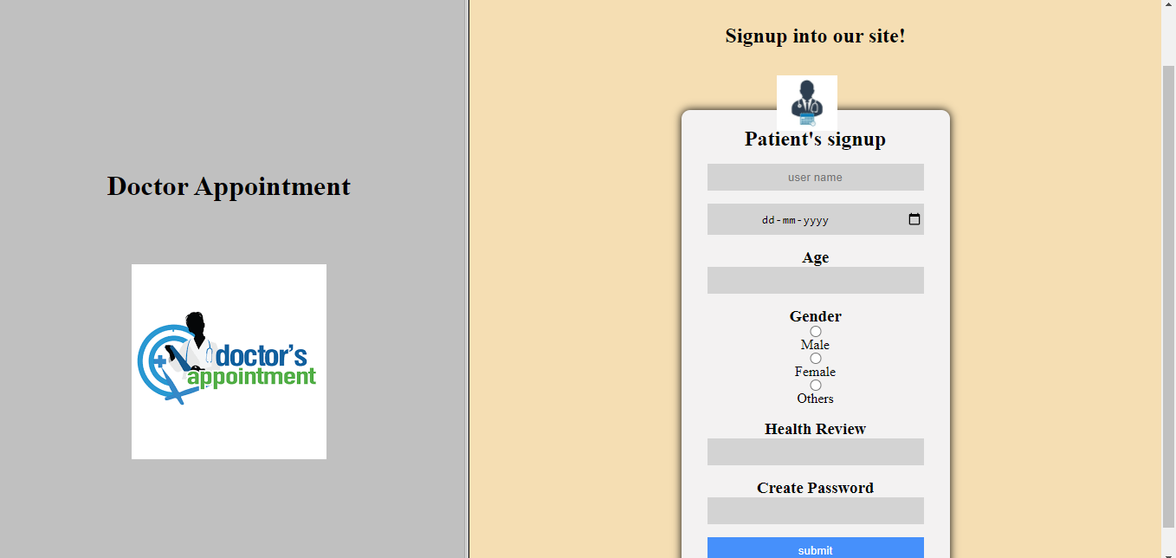

Slide 24

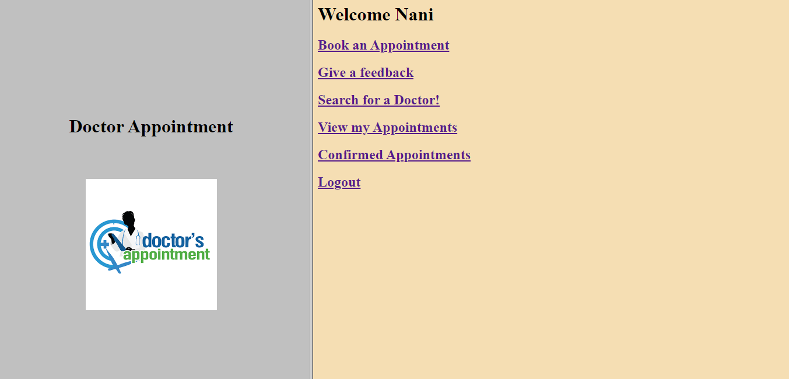

Slide 25
All the above shown were outputs of our web application.
We used Sublime Text ad text Editor and Java for backend database connection.

Slide 26


